Slide 1
IoT and GPS-based soldier position tracking and health monitoring system using ESP32

Slide 2
GROUP MEMBERS
09 -Digvijay Kamble
10 -Revati Gajbhar
11 -Vivek Gajbhiye
12 -Om Gandhal

Slide 3
CONTENT
Overview
List of component
Block Diagram
Results
Conclusion

Slide 4
OVERVIEW
The project involves developing an IoT and GPS-based system for tracking soldier positions and monitoring their health using the ESP32 microcontroller. This system integrates several sensors and hardware components, including the NEO-6M GPS module for location tracking, MAX30102pulse oximeter for monitoring vital signs, LM75 temperature sensor for temperature readings, MPU6050 accelerometer and gyroscope for motion detection. By utilizing the ESP32's capabilities, the system provides real-time data on soldier whereabouts and health status, enhancing situational awareness and ensuring prompt medical assistance when necessary.

Slide 5
LIST OF COMPONENETS
ESP32 Microcontroller.
MAX30100 Pulse Oximeter Heart Rate Sensor Module.
NEO-6M GPS module.
LM75 temperature sensor.
MPU6050 accelerometer and gyroscope.

Slide 6
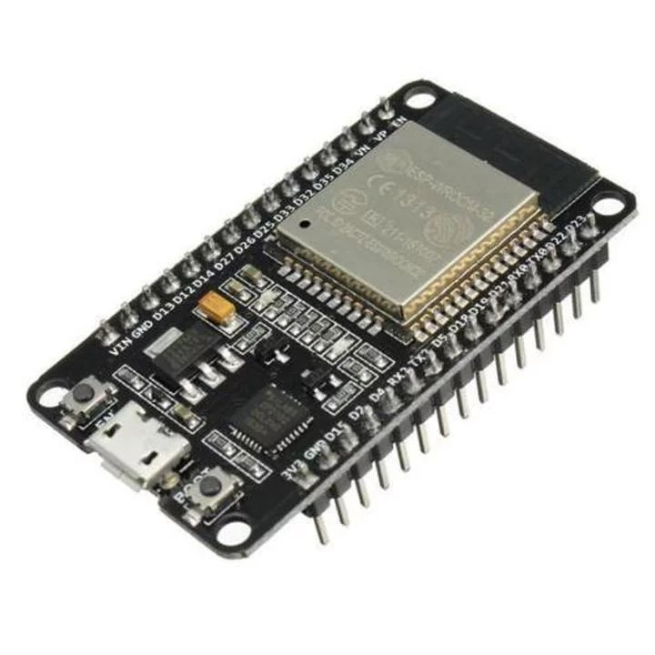
MICROCONTROLLER
The ESP32 Dev WROOM 32 is a powerful development board based on the ESP32 system-on-chip (SoC) by Espressif Systems. It is designed for IoT (Internet of Things) applications and provides a wide range of features for prototyping and development.
Dual-core Xtensa 32-bit LX6 microprocessors, which can be clocked up to 240 MHz
Integrated Wi-Fi and Bluetooth connectivity, making it suitable for various IoT applications.
Rich peripheral set including GPIO, UART, SPI, I2C, ADC, DAC, and more.
Support for multiple low-power modes, enabling efficient power management.
Onboard flash memory for program and data storage.
Various development interfaces such as USB-UART bridge, micro USB port, and JTAG debugging support.

Slide 7
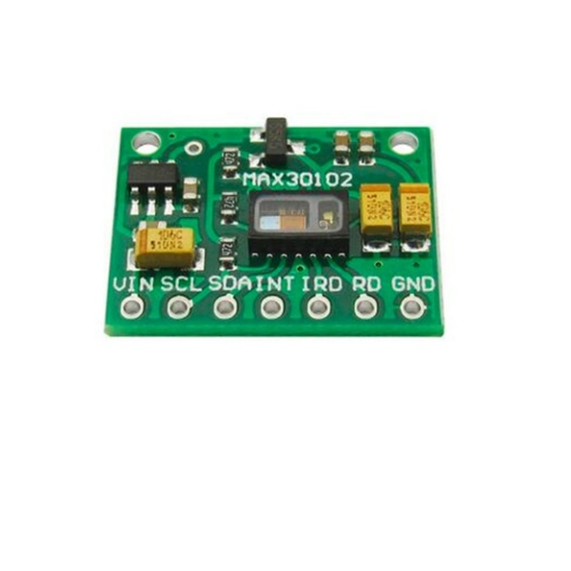
MAX30102 PULSE OXIMETER HEART RATE SENSOR
Utilizes red and infrared (IR) LEDs
Uses I2C interface
Operates on 3.3V
Integrates pulse oximetry and heart rate monitoring
High SNR for robust motion artifact resistance
Capable of high sample rates for precise measurements
Includes ambient light cancellation for accuracy in varied environments

Slide 8
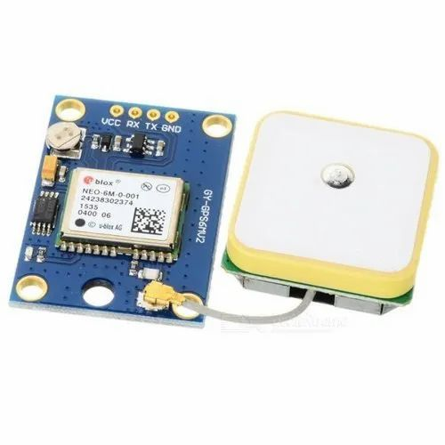
NEO-6M GPS MODULE
GPS module
u-blox NEO-6M GPS receiver
UART/TTL interface
Accuracy is <2.5 meters
Update Rate Up to 5Hz
-161 dBm tracking sensitivity
Power Supply of 3.3V to 5V DC input
Operating Temperature is -40°C to +85°C
Compact form factor
External active antenna required
Easy integration into various projects

Slide 9
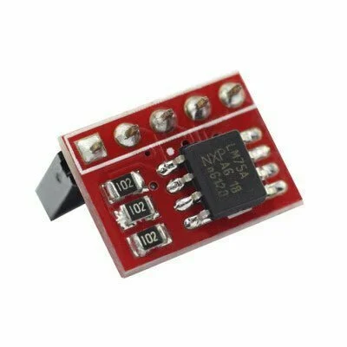
LM75 TEMPERATURE SENSOR
I2C-compatible interface
Temperature Range is -55°C to +125°C
Accuracy is ±2°C typical (from -25°C to +100°C)
0.125°C Resolution
2.8V to 5.5V voltage supply.
Low-power shutdown mode available
Available in small packages like SOT-23 and SO-8
Suitable for various temperature sensing applications

Slide 10
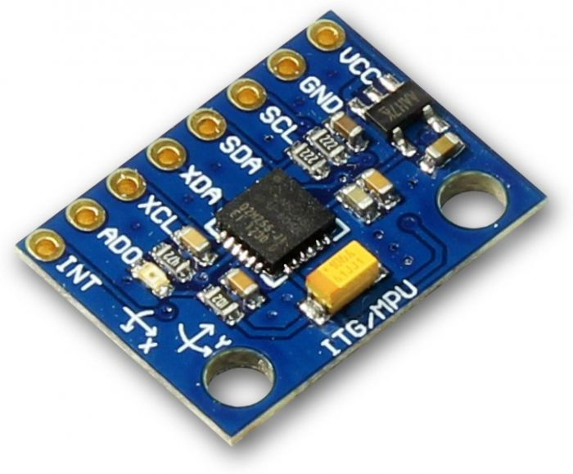
MPU6050 ACCELEROMETER & GYROSCOPE
Operating voltage range of 2.375V to 3.46V for the MPU-6050, and 2.375V to 5.5V for the MPU-6050A.
Communication Interface.
I2C serial interface with a maximum clock frequency of 400kHz.
8-bit and 16-bit register access modes.
3-axis sensing with a full-scale range of ±250, ±500, ±1000, or ±2000 degrees per second (dps) for gyroscope.
output data rate (ODR) range of 8kHz to 1.25Hz for gyroscope.
3-axis sensing with a full-scale range of ±2g, ±4g, ±8g, or ±16g for accelerometer.
Operating range of -40°C to +85°C for accelerometer.

Slide 11
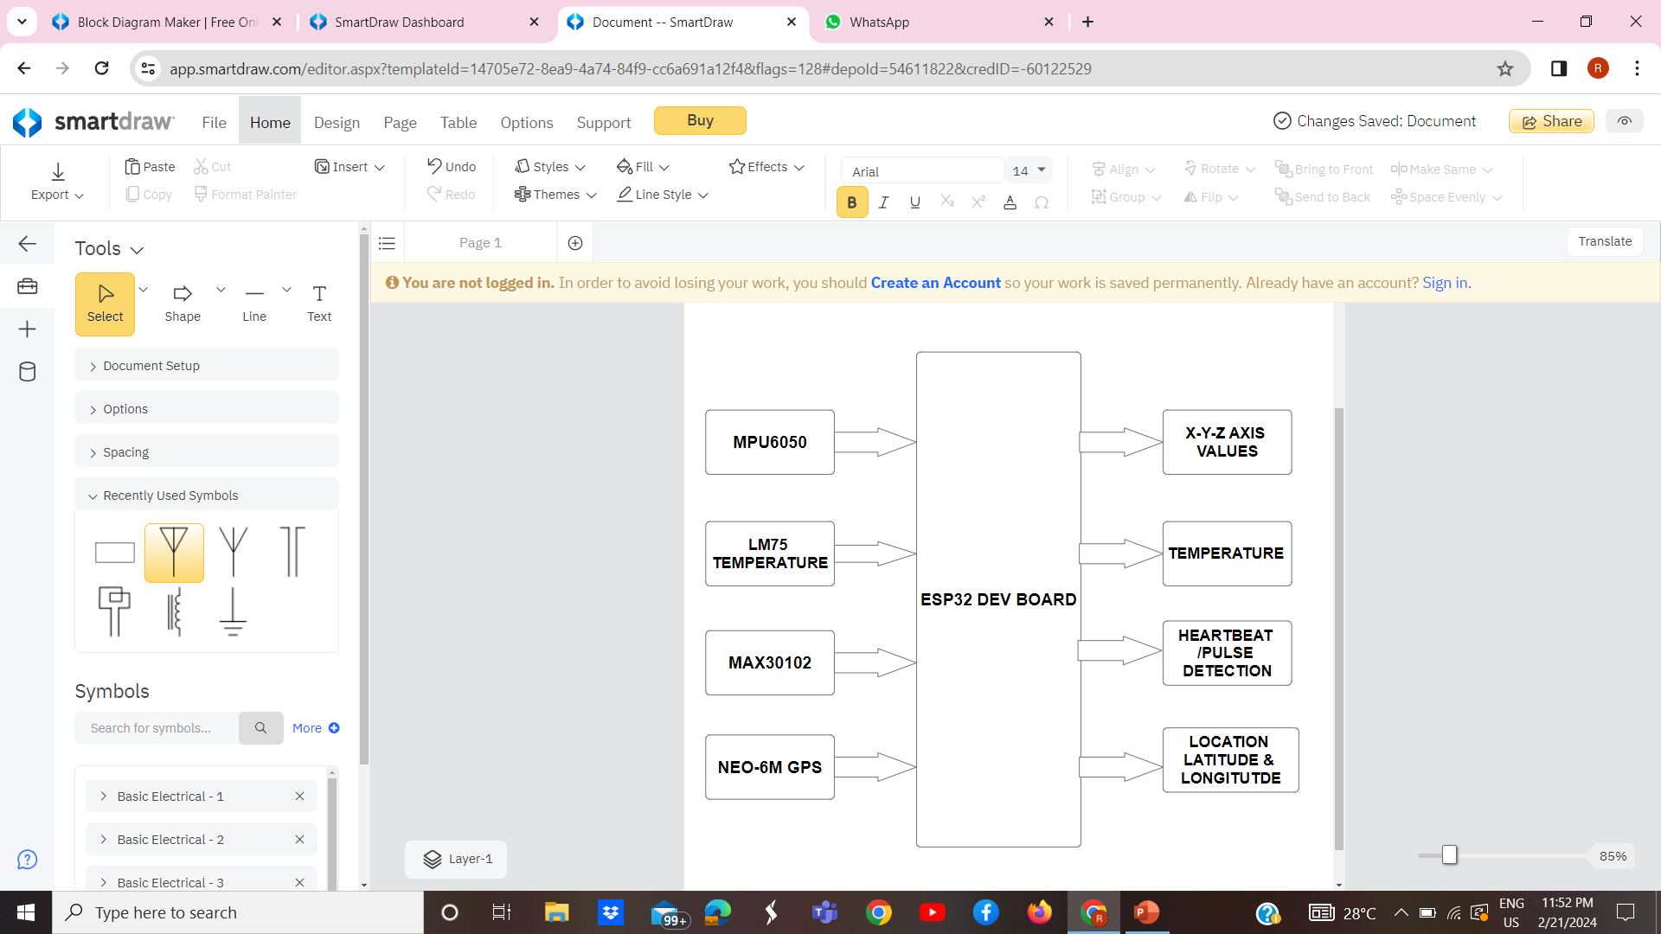
BLOCK DIAGRAM
DATA

Slide 12
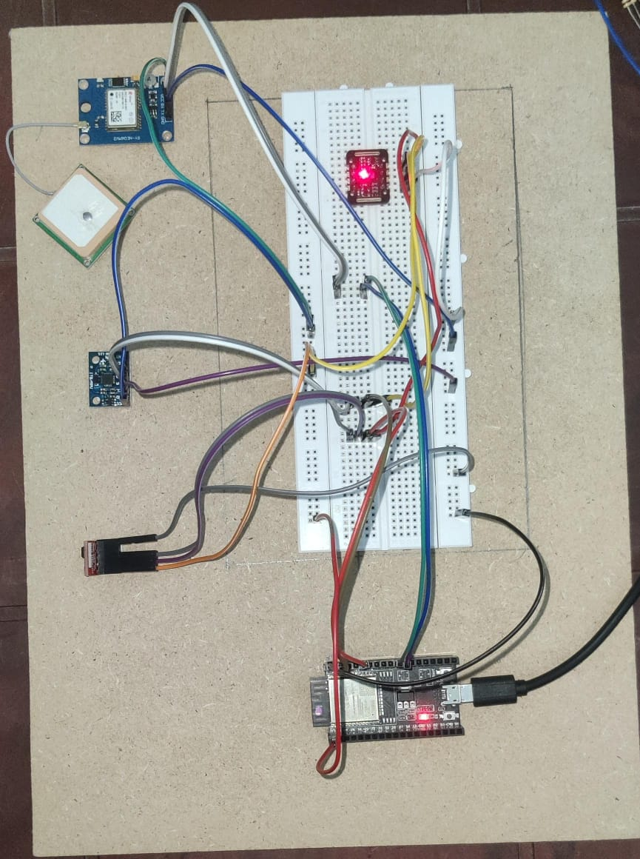
CIRCUIT DIAGRAM

Slide 13
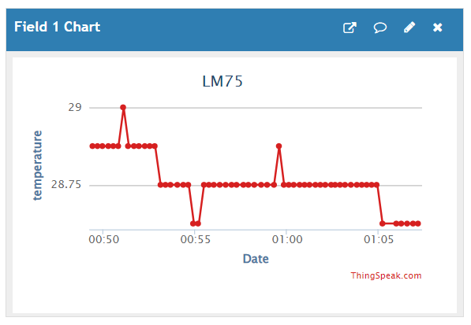
RESULT(TEMPERATURE)

Slide 14
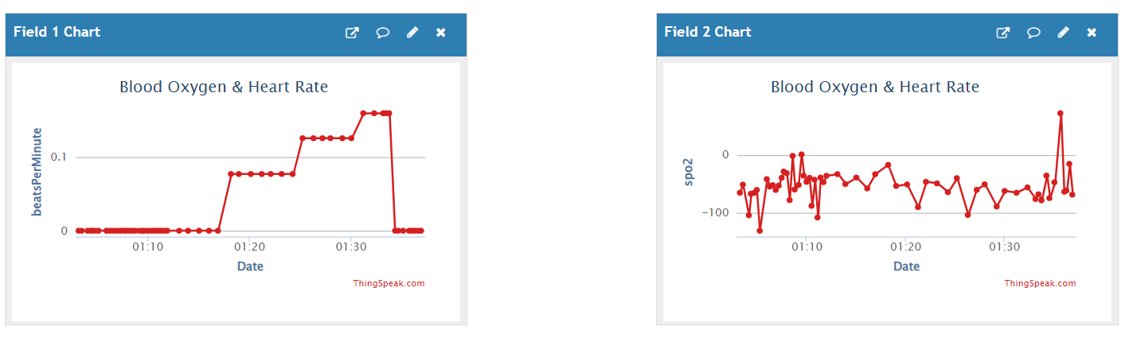
RESULT(PULSE OXIMETER)

Slide 15
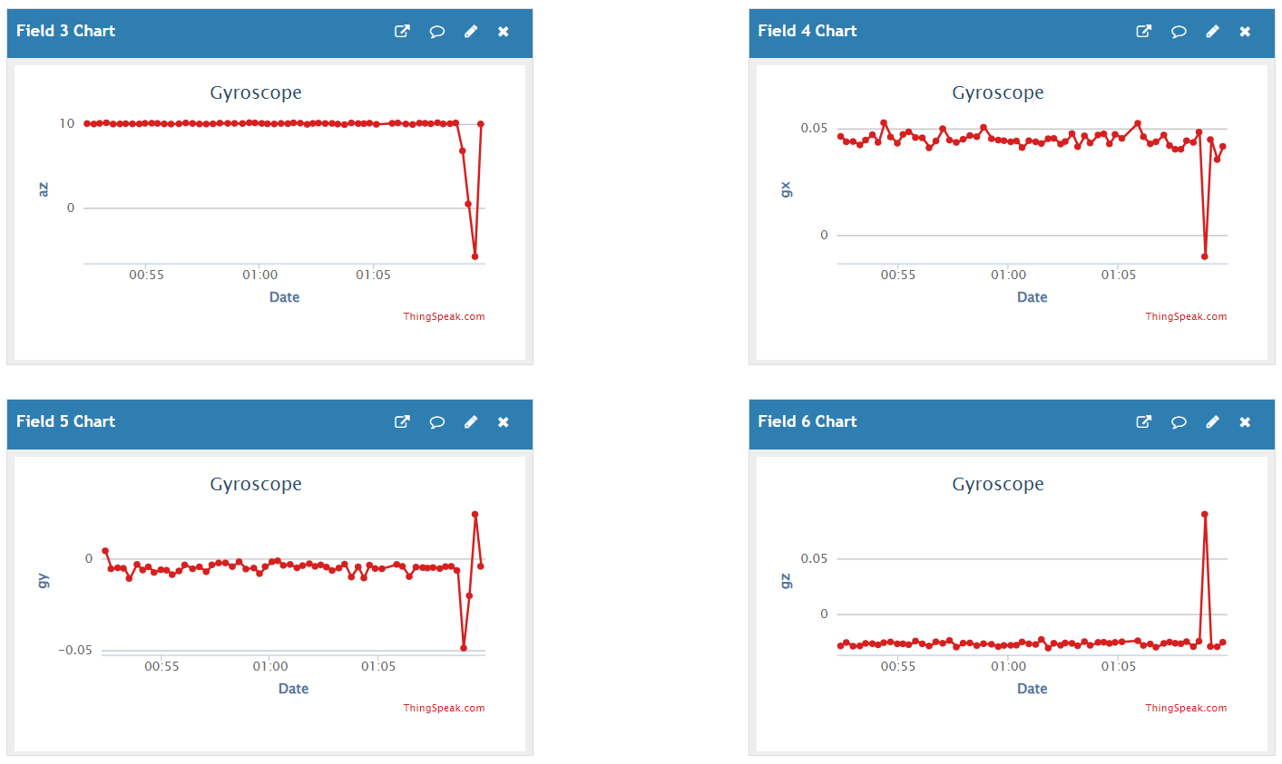
RESULT (ACCELERATION)

Slide 16
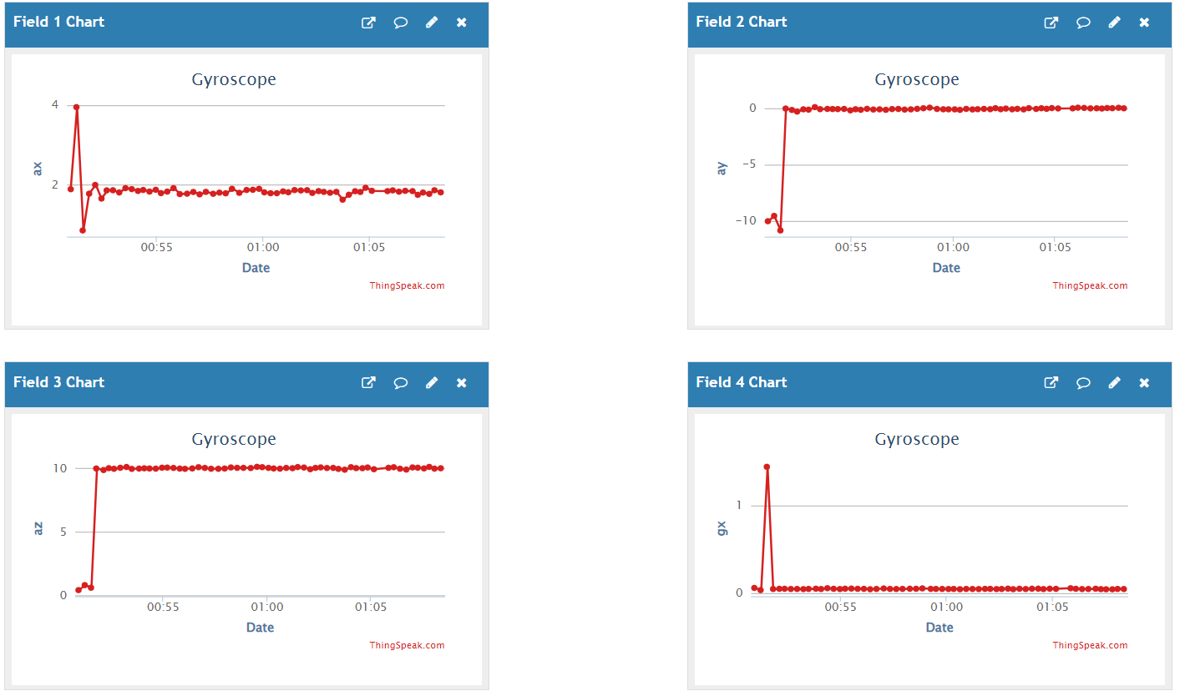
RESULT(GYROSCOPE)

Slide 17
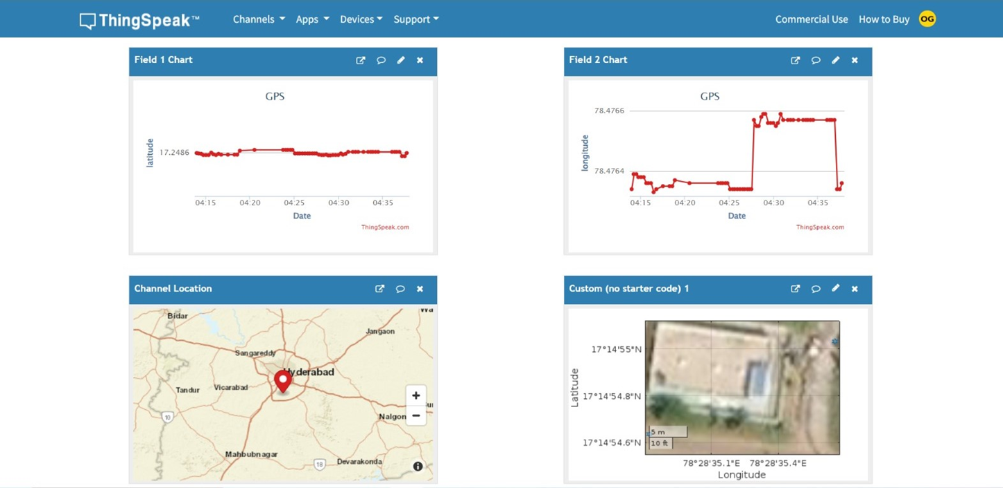
RESULT(GPS)

Slide 18
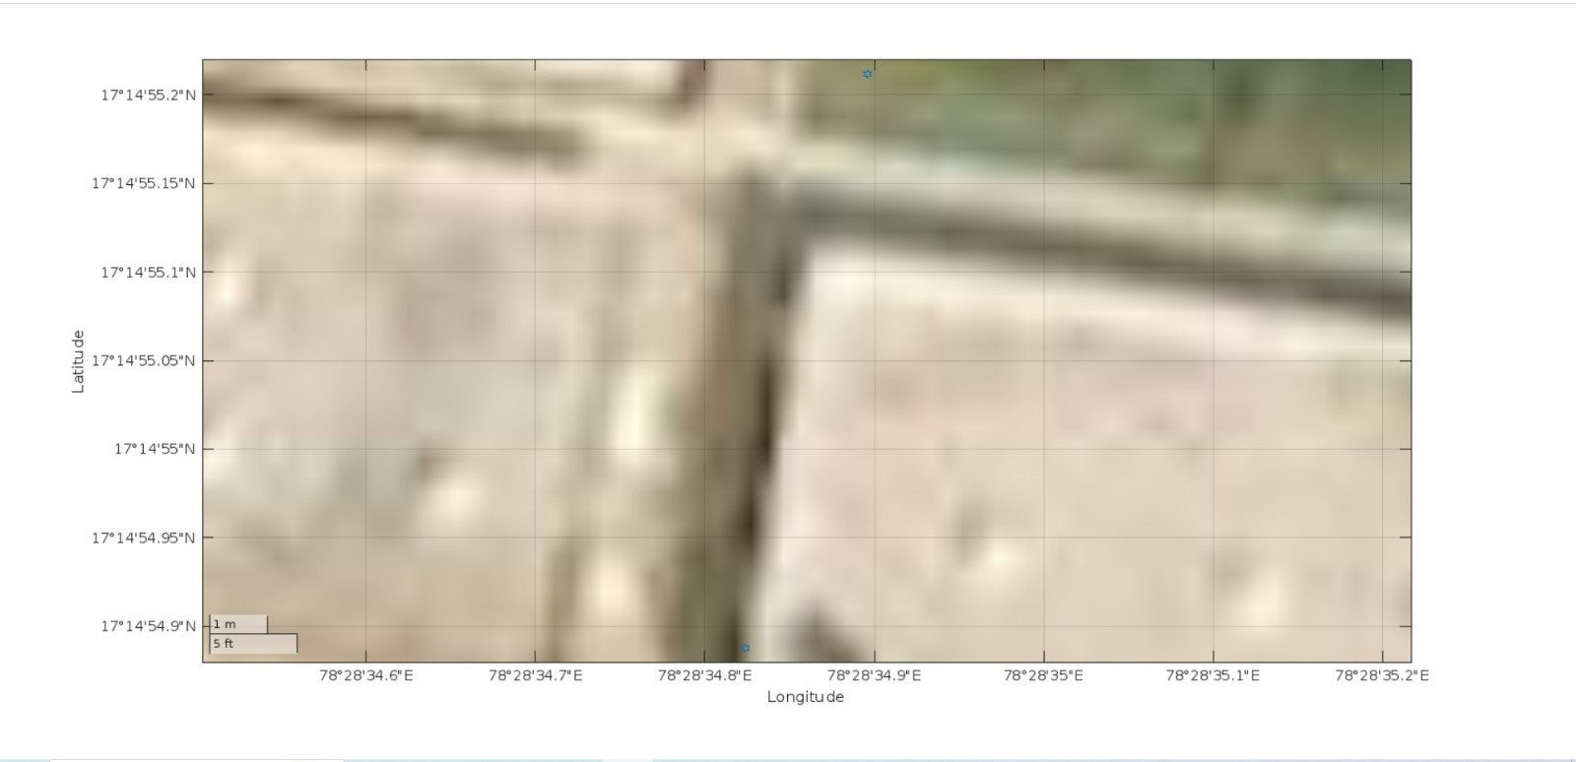

Slide 19
CONCLUSION
The project aims to develop an IoT and GPS-based system using the ESP32 microcontroller to track soldier positions and monitor their health in real-time, providing enhanced situational awareness and facilitating prompt medical assistance when needed.

Slide 20
THANK YOU

